Slide 1

Housing price prediction Capstone Project
Khoa Truong

Slide 2
Idea behind this project
Get the latest monthly housing price data to predict house prices.
Since housing prices don’t fluctuate like stocks in the financial market, the predicted price can last at least one quarter to a year with small deviation from the actual price.
Save time on picking the house you want to buy.
Or have a better estimation of the house price.

Slide 3
Overall methodology of predicting housing price
Download monthly data from Zillow rapid-API. Number of samples: 10000 to 15000.
Clean the datasets for EDA. Use unsupervised learning to see if the raw features can really distinguish housing prices.
Create new features and targets based on the EDA. Then, build deep learning models.
Build 3 ANN models:
+ ANN_location: predict price/lotsqft based on location.
+ ANN_properties: predict price of the inner part of the house.
+ ANN_price: predict the price of the house based on other features and the results of the first 2 models.
Use R-squared and MAPE with cross 5-folds validation to evaluate the performance of the model on monthly data.

Slide 4
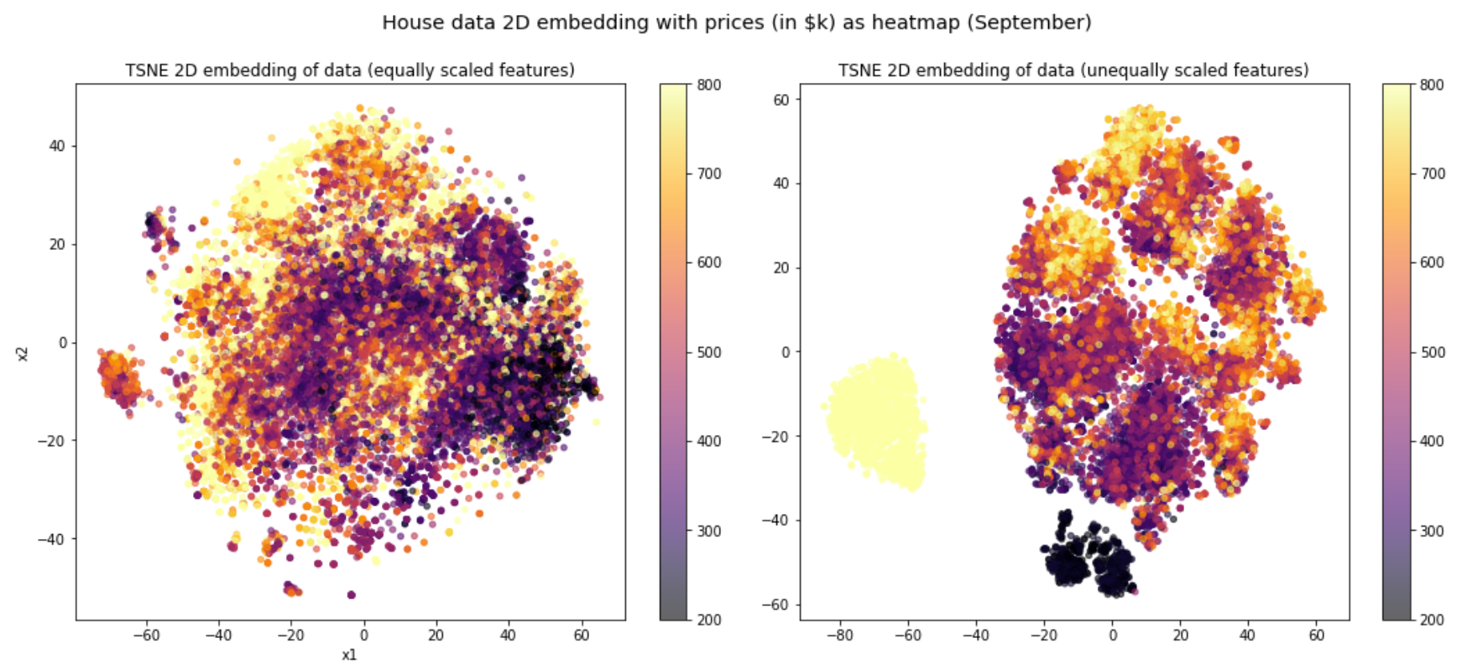
TSNE 2D Embedding

Slide 5
Restrictions for the datasets
Datapoints that are not allowed to be in the datasets:
Lot Area (sqft) = 0 and lot Area (sqft) >100000. (“Hybrid” house: A house and a barn at once).
Price/lotsqft > $1000: Lot Area is small. This is more of an expensive apartment or townhome.
Liv/lot_ratio > 2: Living area is double the lotArea. It is likely a whole townhome.

Slide 6
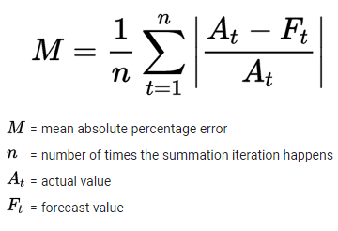
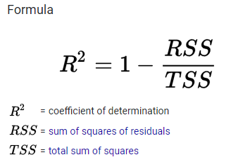
Metrics
AE: Absolute Error = |actual_value – predicted_value|
APE: Absolute Percentage Error = |AE/actual_value| * 100
MAPE: Mean Absolute Percentage Error
R-squared: range from 0 to 1.

Slide 7
Why liv/lot ratio is important?
Liv/lot ratio = living area (sqft) / lot area (sqft).
Location: City or suburban area.
Characteristic: Suburban houses tend to have more lot area than urban houses. While suburban houses are more flat (lower liv/lot ratio), urban houses have more stories (higher liv/lot ratio).
Price: Houses with more living area are usually more expensive.

Slide 8
Definitions of the targets
Actual_price: Actual price of the house.
Living_price: The price of the interior area of the house.
If liv/lot ratio > 1, living_price = actual price.
Else, living_price = liv/lot ratio * actual price.
Price/livingsqft = Actual_price/livingarea.
Price/lotsqft = Actual_price/lotarea.

Slide 9
LOCATION EDA AND DL

Slide 10
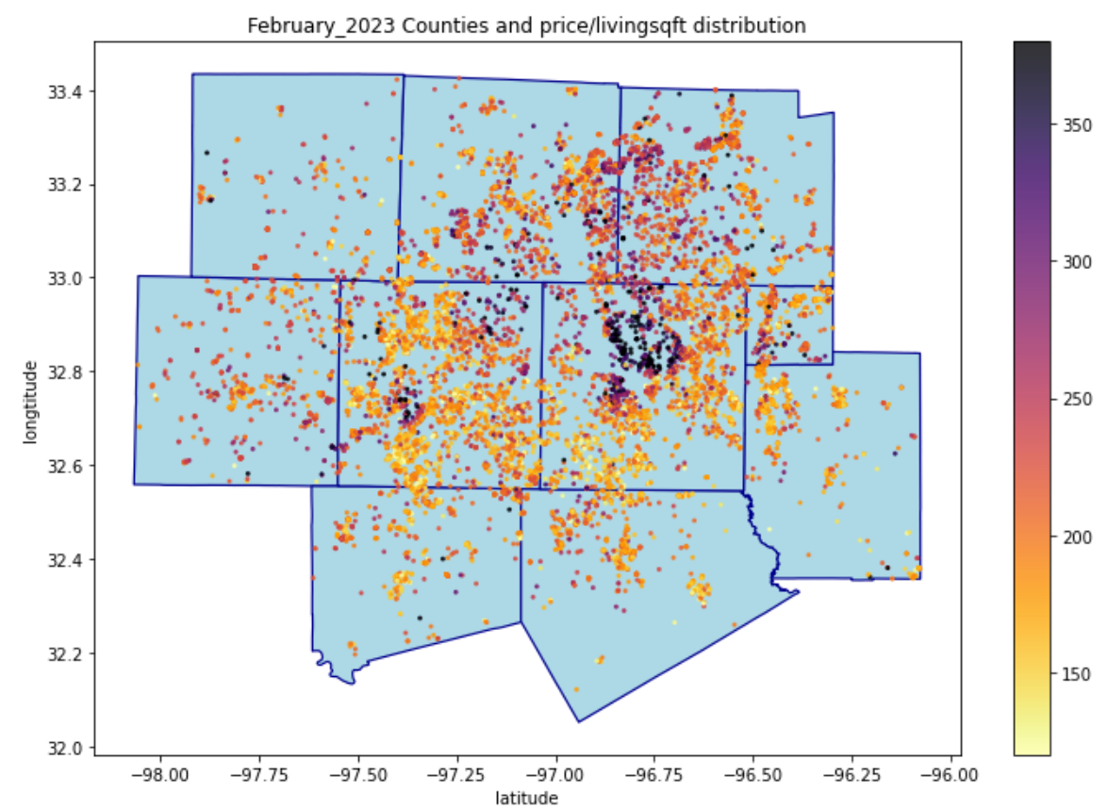
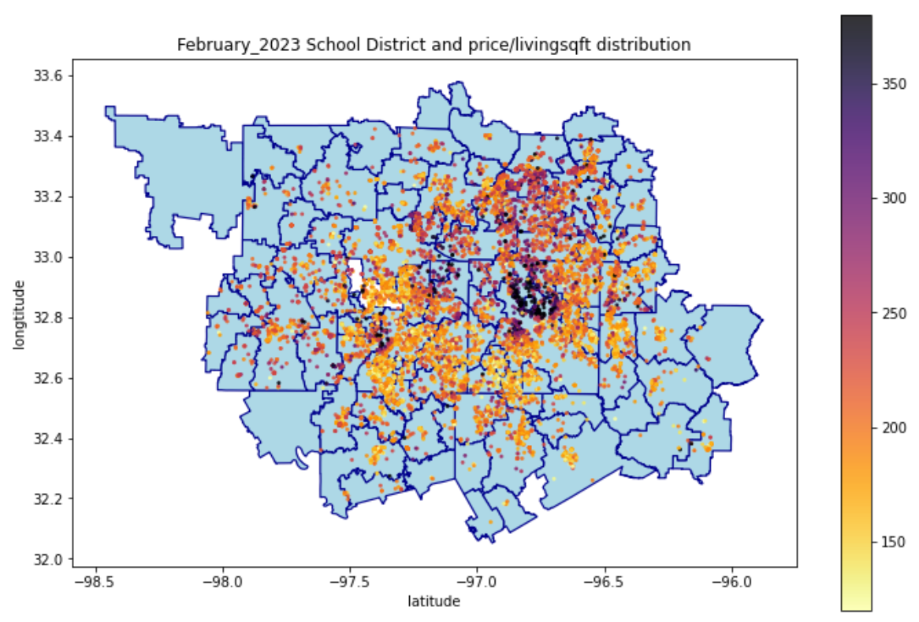
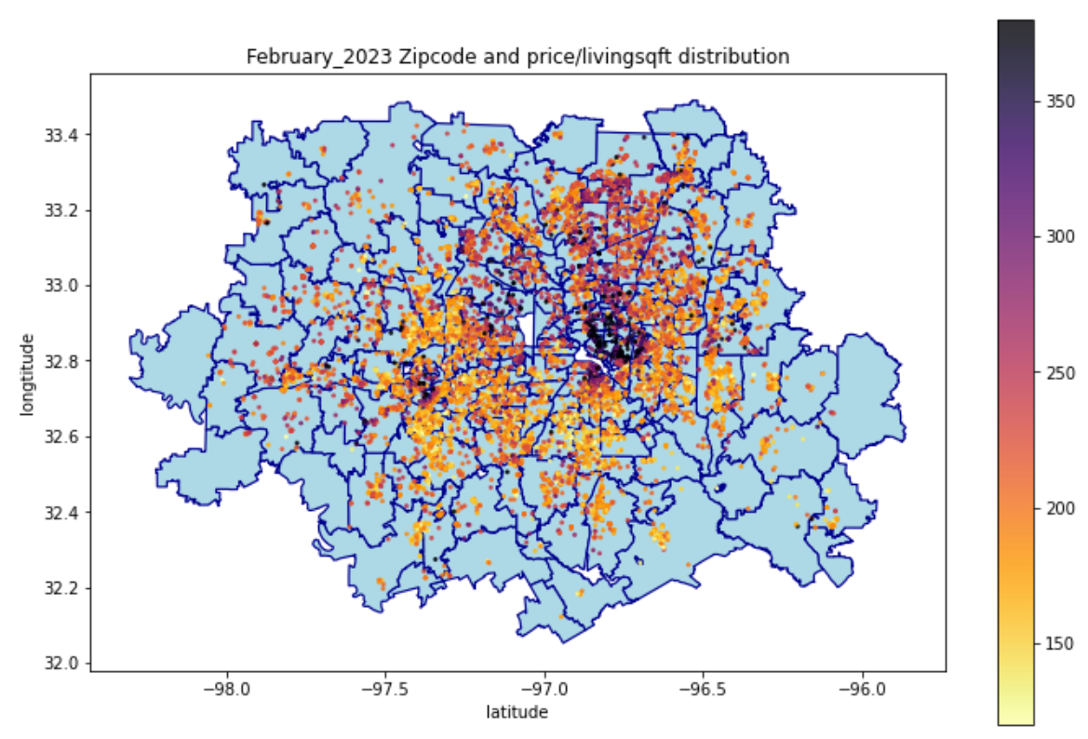
Price/livingsqft distribution with location
WISE
DENTON
COLLIN
ROCKWALL
PARKER
TARRANT
DALLAS
KAUFMAN
JOHNSON
ELLIS

Slide 11
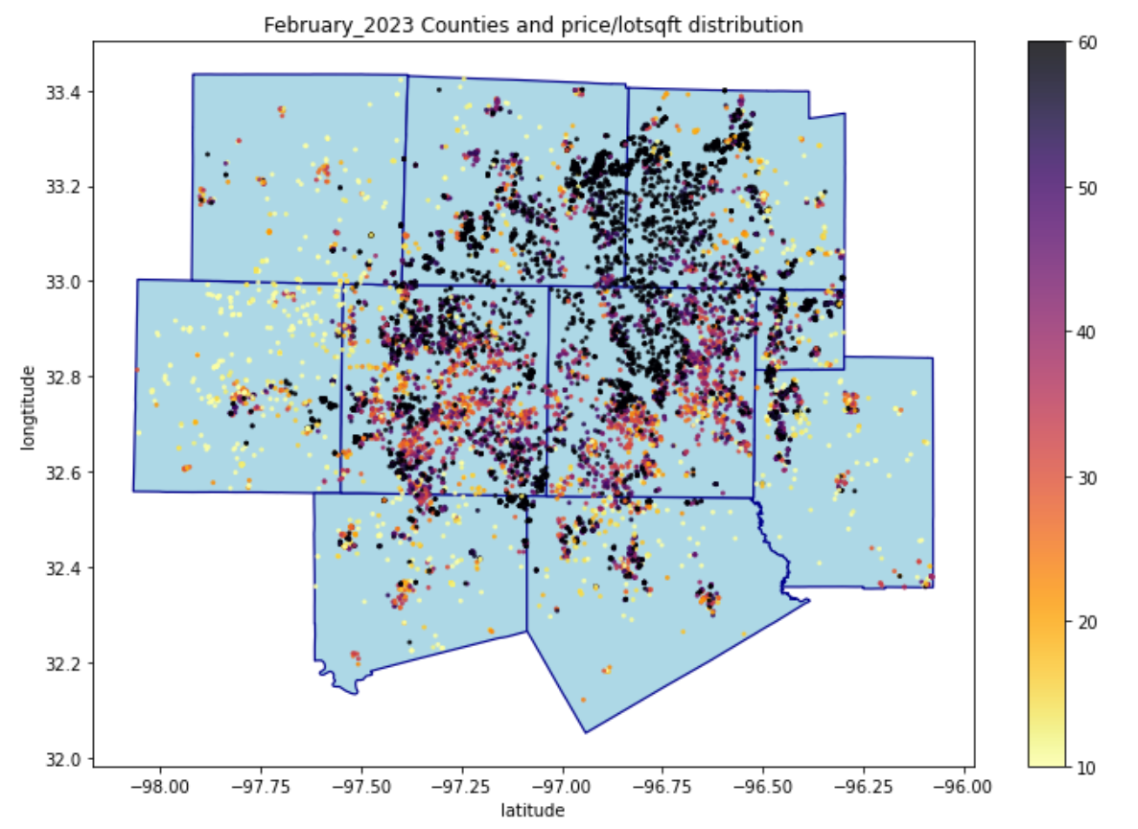
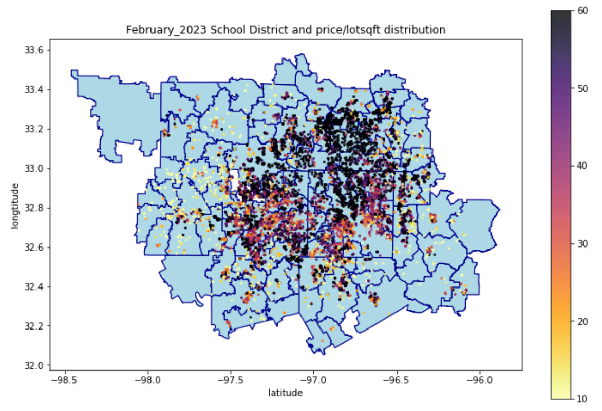
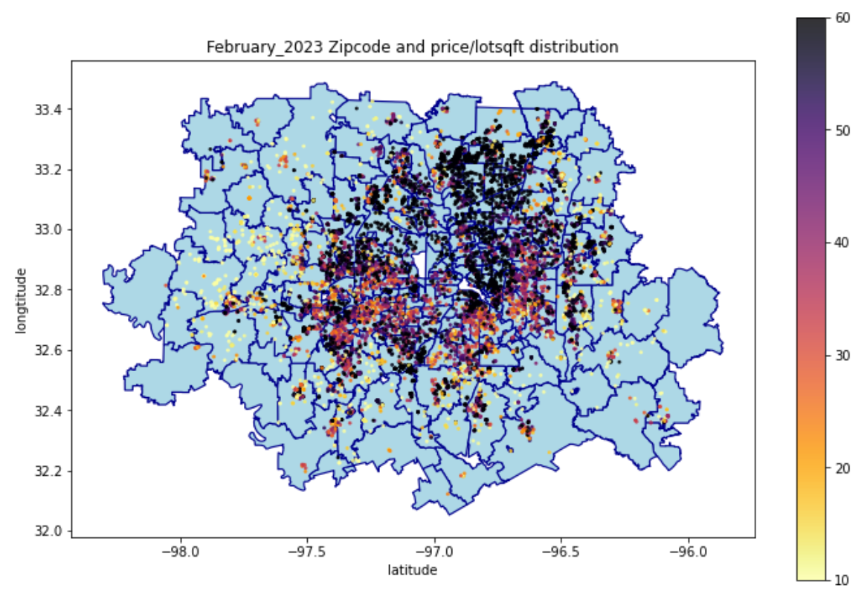
Price/lotsqft distribution with location
WISE
DENTON
COLLIN
ROCKWALL
PARKER
TARRANT
DALLAS
KAUFMAN
JOHNSON
ELLIS

Slide 12
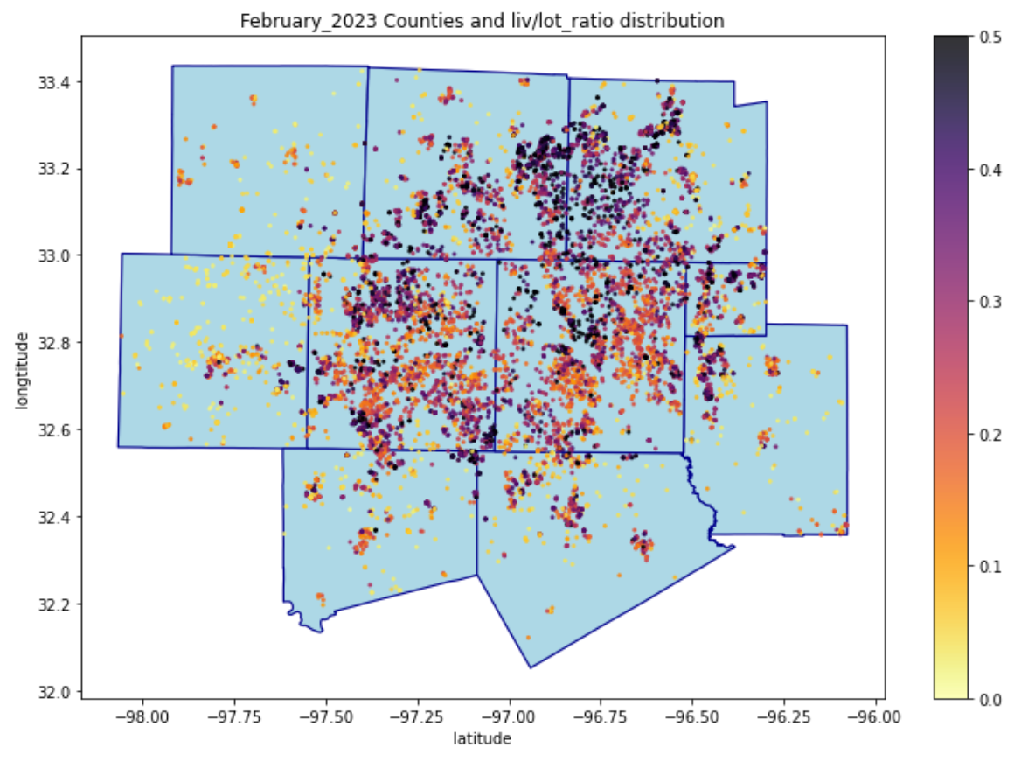
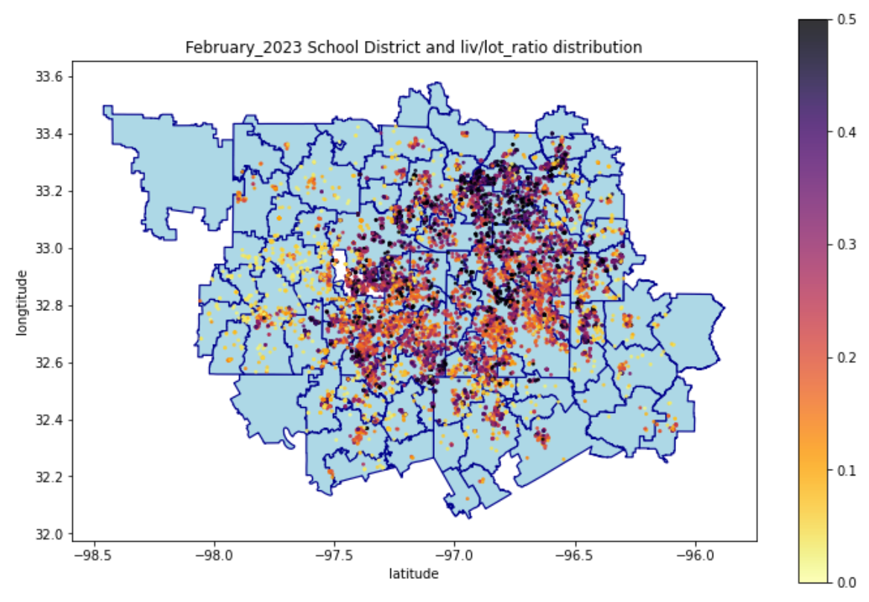
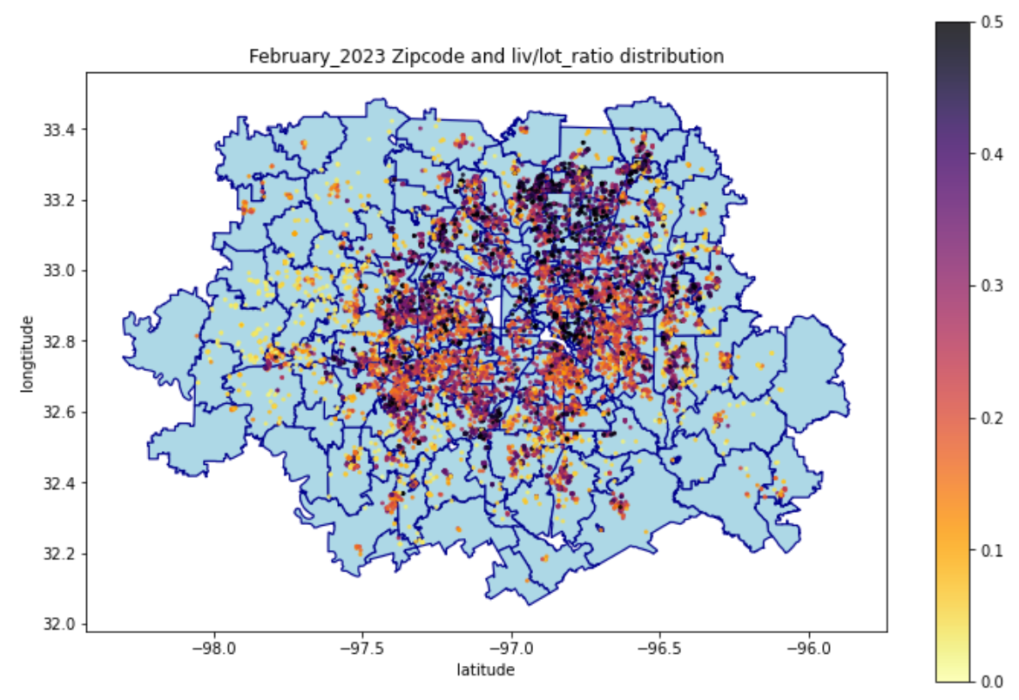
Liv/lot_ratio distribution
WISE
DENTON
COLLIN
ROCKWALL
PARKER
TARRANT
DALLAS
KAUFMAN
JOHNSON
ELLIS

Slide 13
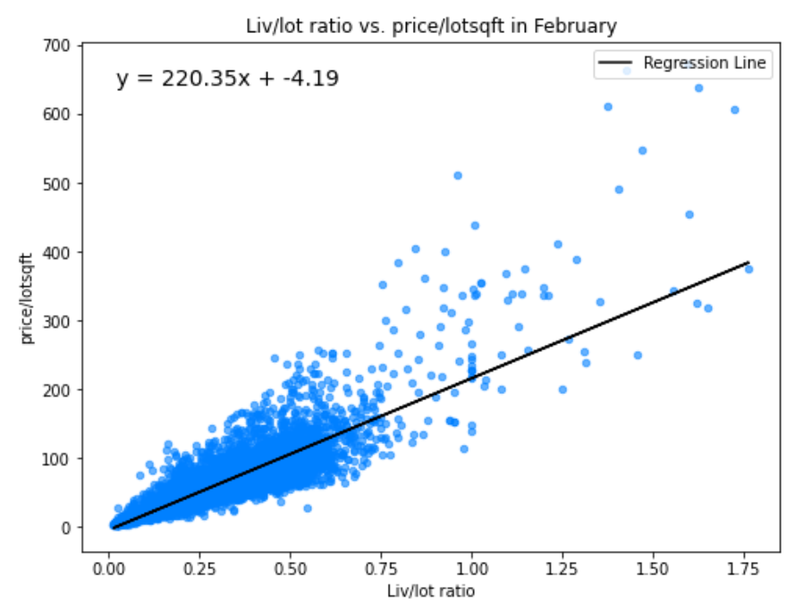
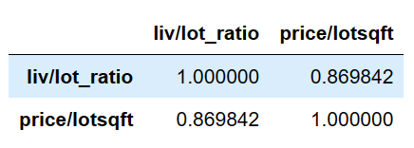
Liv/lot_ratio vs. price/lotsqft

Slide 14
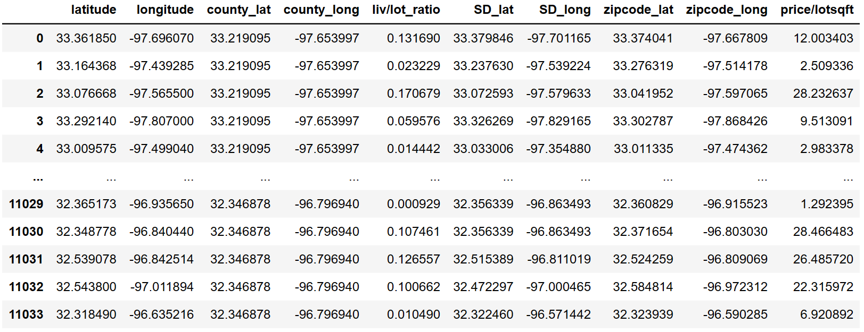
LOCATION FEATURES AND TARGET
Table of February 2023 Data
Using the coordinates of the centers of counties, School District, zipcodes instead of the number and names.
Liv/lot_ratio served as location feature.
Target: price/lotsqft.

Slide 15

2000 neurons each layer, with the final 2 layers with dropouts = 0.2
Dense -> ReLu -> Dropout
5-Fold Cross Validation
Scale 9 Features with MinMaxScaler()
Scale target with np.log
Evaluate the model with np.exp(predictions)
Epochs = 80; batch size = 32
Loss: mse; Optimizer: Adam with special learning rate schedule.
Learning rate schedule with decay_steps = 990, decay_rate = 0.85, initial learning rate = 0.001.
ANN_LOCATION ARCHITECTURE

Slide 16
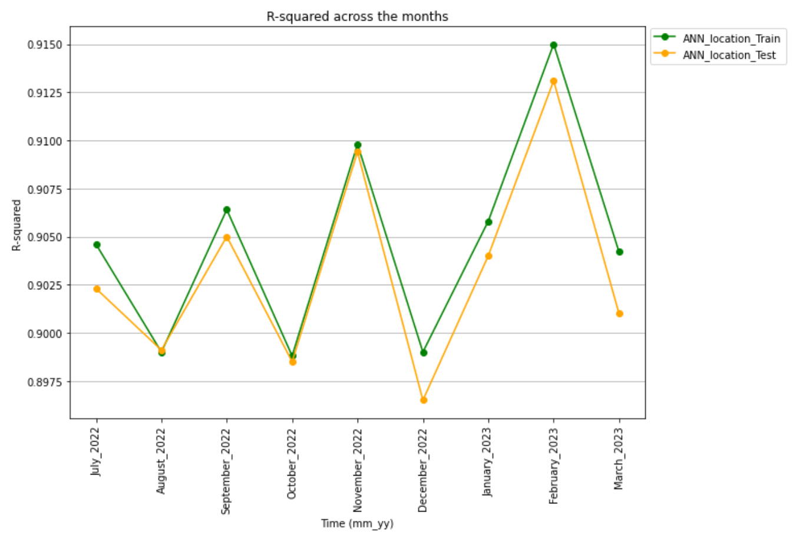
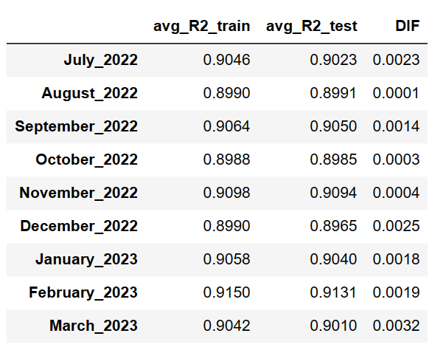
R-squared comparison (price/lotsqft)
DIF: 0.01% to 0.32%
ANN generalizes very well.

Slide 17
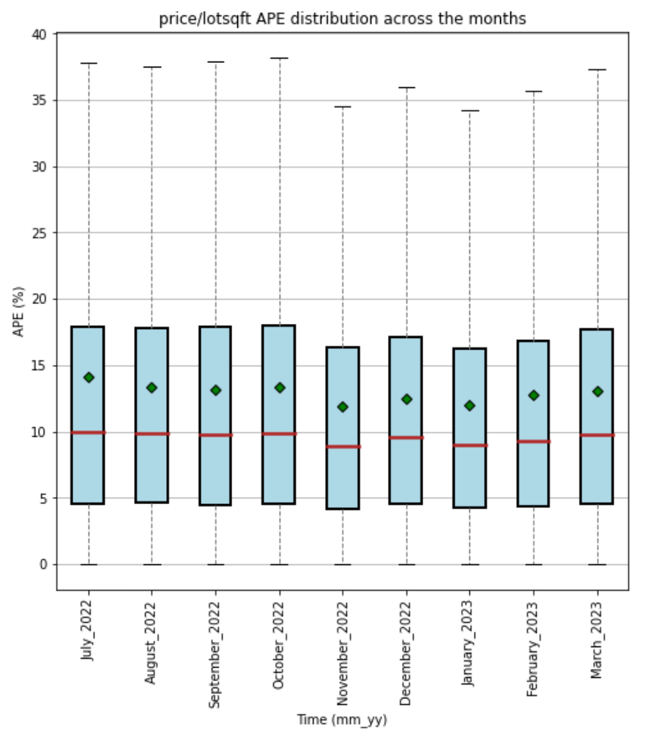
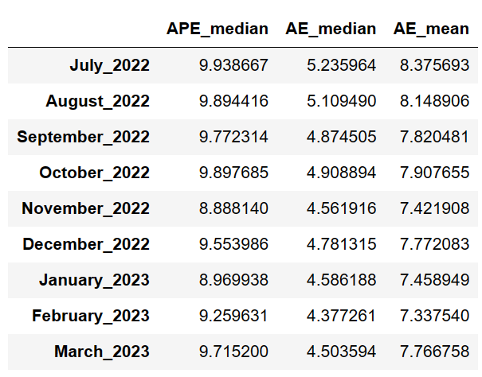
AE and APE of price/lotsqft
APE_median: 8.9% to 9.9%
AE_median: $4.38 to $5.23
AE_mean: $7.34 to $8.38

Slide 18
LIVING PRICE EDA AND DL

Slide 19
Features and target
9 True of False features: 'isSeniorCommunity', 'hasAssociation', 'hasPrivatePool', 'hasGarage', 'hasAttachedGarage', 'hasCarport', 'hasSpa', 'hasFireplace', 'isNewConstruction’.
10 Numerical features: 'monthlyHoaFee', 'liv/lot_ratio', 'bedrooms', 'carportSpaces', 'garageSpaces', 'coveredSpaces', 'parking', 'bathroomsHalf', 'bathroomsFull', 'fireplaces’.
11 Multiple-categories features: levels, laundry, flooring, construction, exterior, interior, appliances, foundations, lotFeatures, security, sewer of the house.
Target: Living_price.

Slide 20
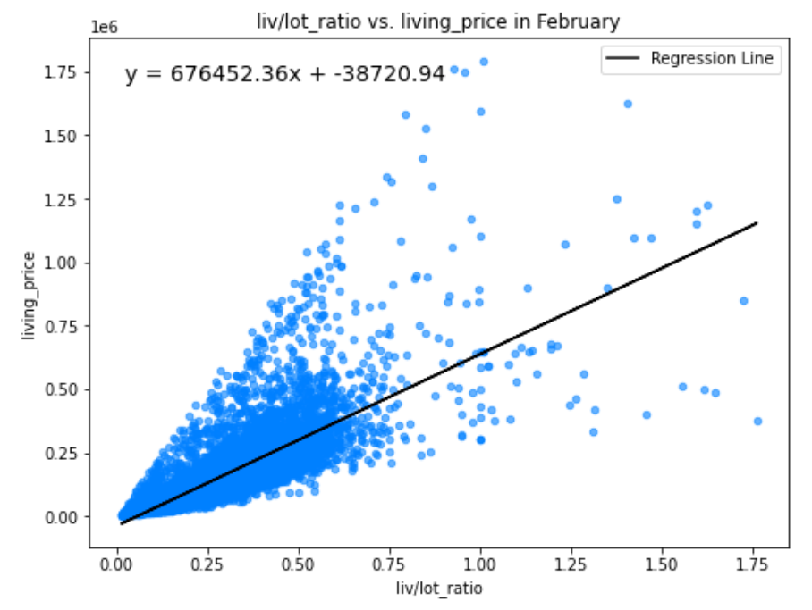
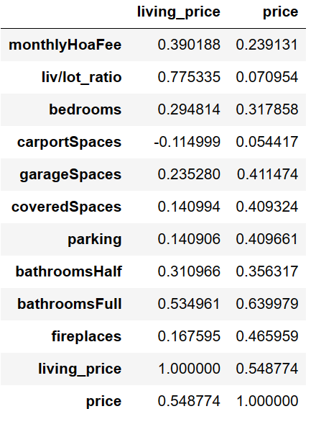
Liv/lot_ratio vs living price Correlation table

Slide 21
4 final layers have 2000 neurons each layer, with the final 2 layers with dropouts = 0.2
Dense -> ReLu -> Dropout
First layer: 80 neurons
Second layer: 60 neurons
Third layer: 20 neurons
Activation: ‘relu’
Batch size = 32; Epochs = 80
Loss: mse; Optimizer: Adam with no learning rate schedule.
5-Fold Cross Validation
Scale Numerical Features with MinMaxScaler()
One-hot encoding the variables with multiple categories
0 and 1 for True of False categorical variable
Scale target with np.log
Evaluate the model with np.exp(predictions)
ANN_PROPERTIES ARCHITECTURE

Slide 22
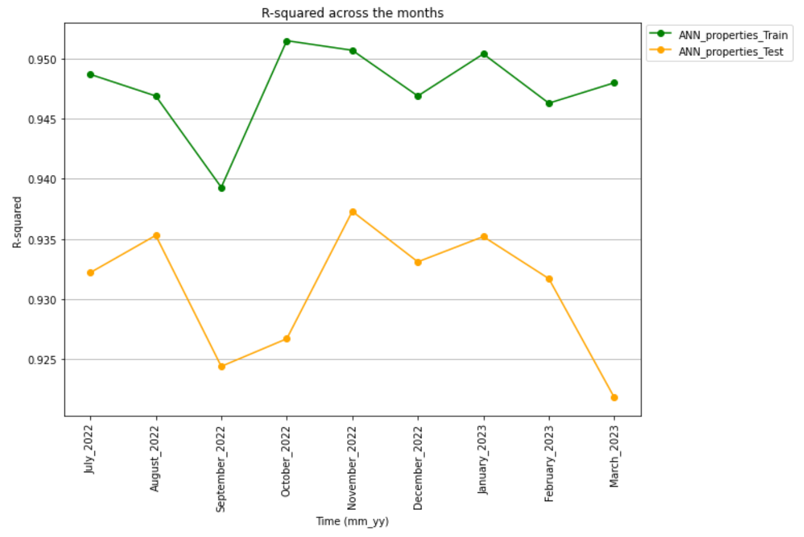
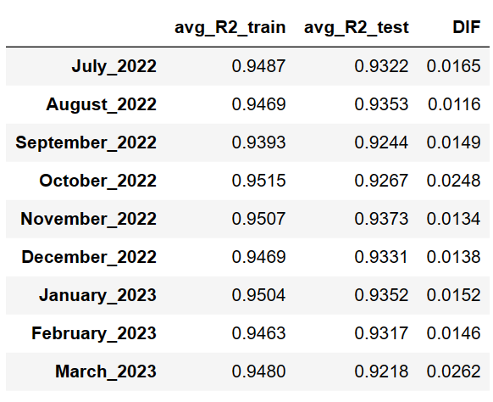
R-squared comparison (Living_price)
DIF: 1.16% to 2.62%
ANN generalizes well.

Slide 23
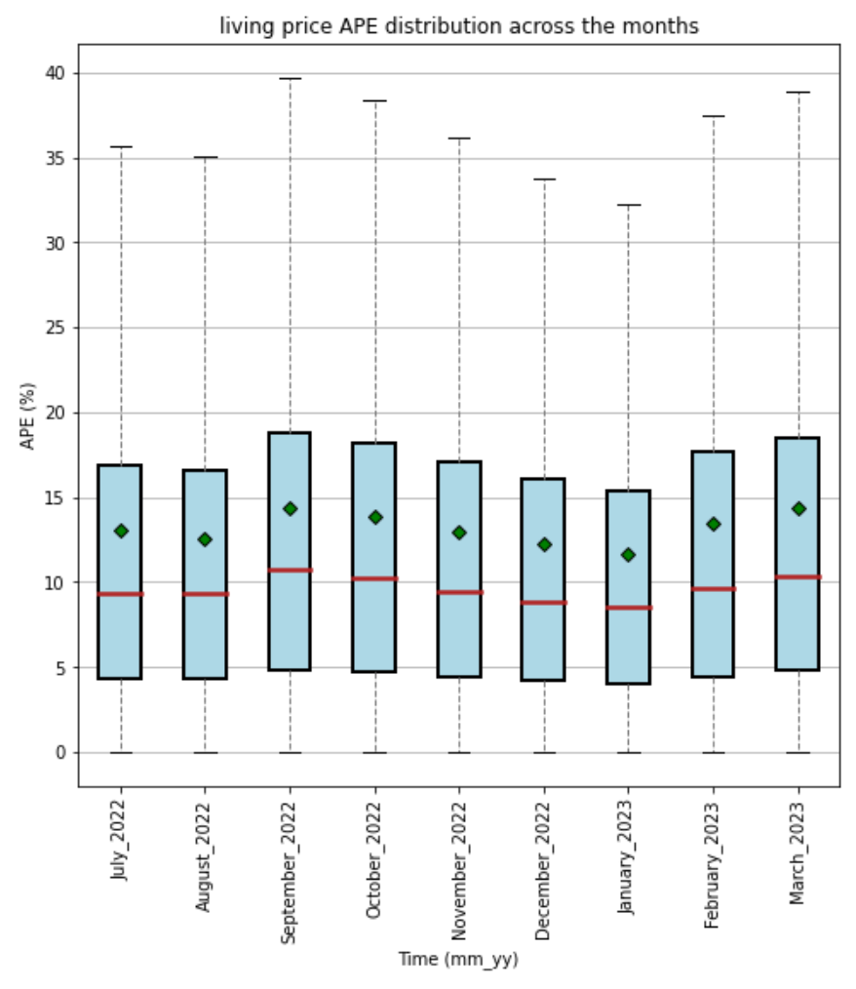
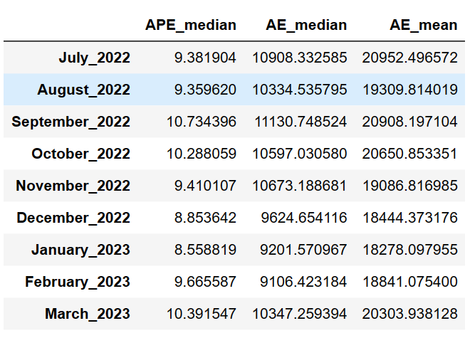
APE and AE of Living price
APE median: 8.56% to 10.73%
AE_median: $9106.42 to $11130.75
AE_mean: $18270.10 to $20952.50

Slide 24
Predicting the actual housing price

Slide 25
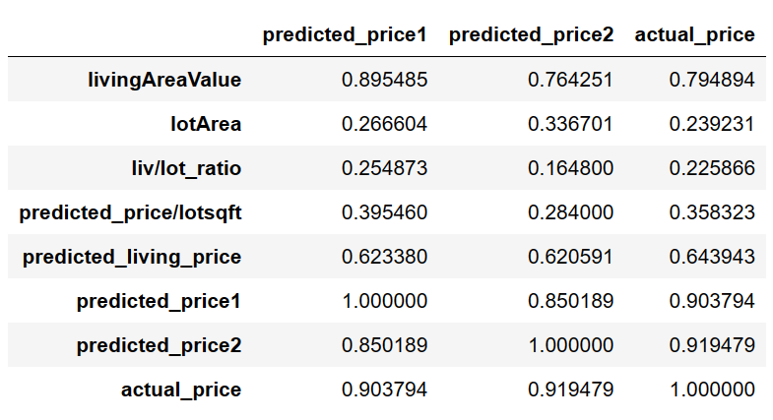
ANN_price features and target
Table of August 2022 Data (Combined test folds)
Predicted_price1 = lotArea * predicted_price/lotsqft
Predicted_price2 =
Predicted_living_price if liv_lot_ratio > 1.
(1/liv_lot_ratio) * predicted_living_price if liv_lot_ratio <=1.
Multicollinearity is acceptable since these newer features are created from the older features.
Based on later results, the model didn’t overfit.

Slide 26
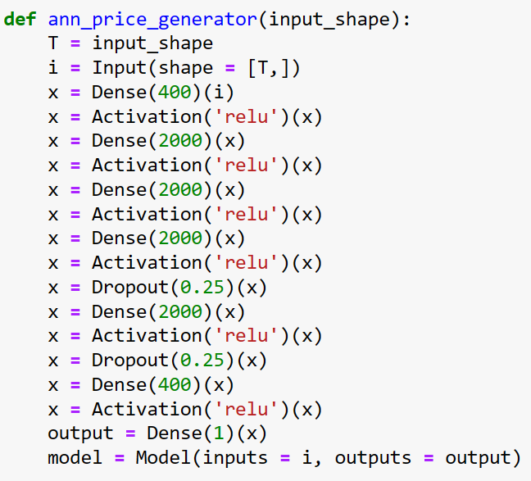
ANN_price architecture
LivingAreaValue = x1
Loss = MSE; optimizer = Adam
Batch_size = 32; Epochs = 80.
lotArea = x2
Liv/lot_ratio = x1/x2
5-Fold Cross Validation
Scale 7 Features with MinMaxScaler()
Scale target with np.log
Evaluate the model with np.exp(predictions)
Predicted_price_lotsqft (ANN_location’s output)
Predicted_living_price
(ANN_properties_output)
Predicted_price1
(ANN_location’s output * x2)
Predicted_price2
(ANN_properties_output * (1/liv_lot_ratio) )***
***: Adjusted based on liv/lot_ratio

Slide 27
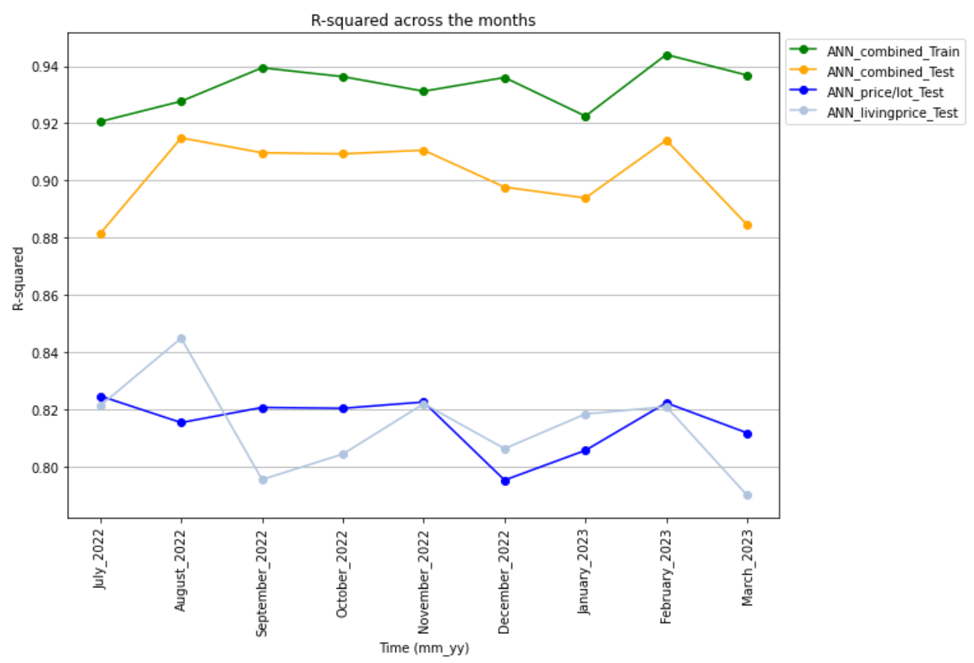
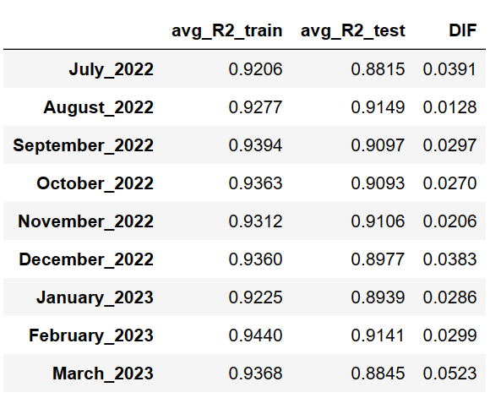
R-squared comparison
DIF: 1.28% to 5.23%
ANN generalizes well.

Slide 28
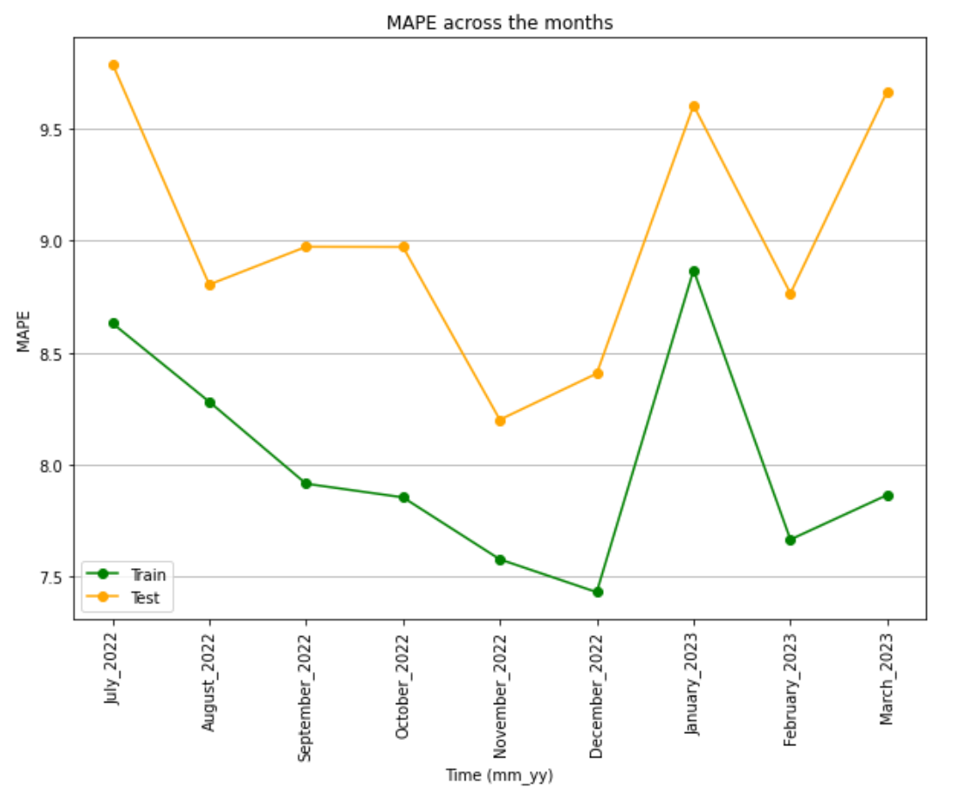
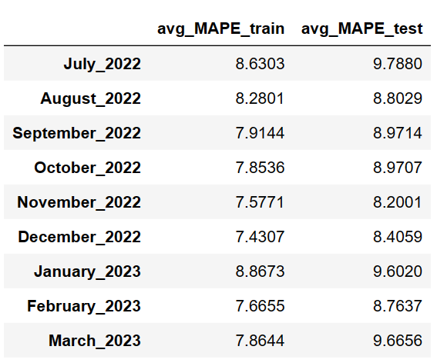
MAPE Comparison
MAPE: 8.2% to 9.8%
Average predictions are off by 8.2% to 9.8% from the actual values.

Slide 29
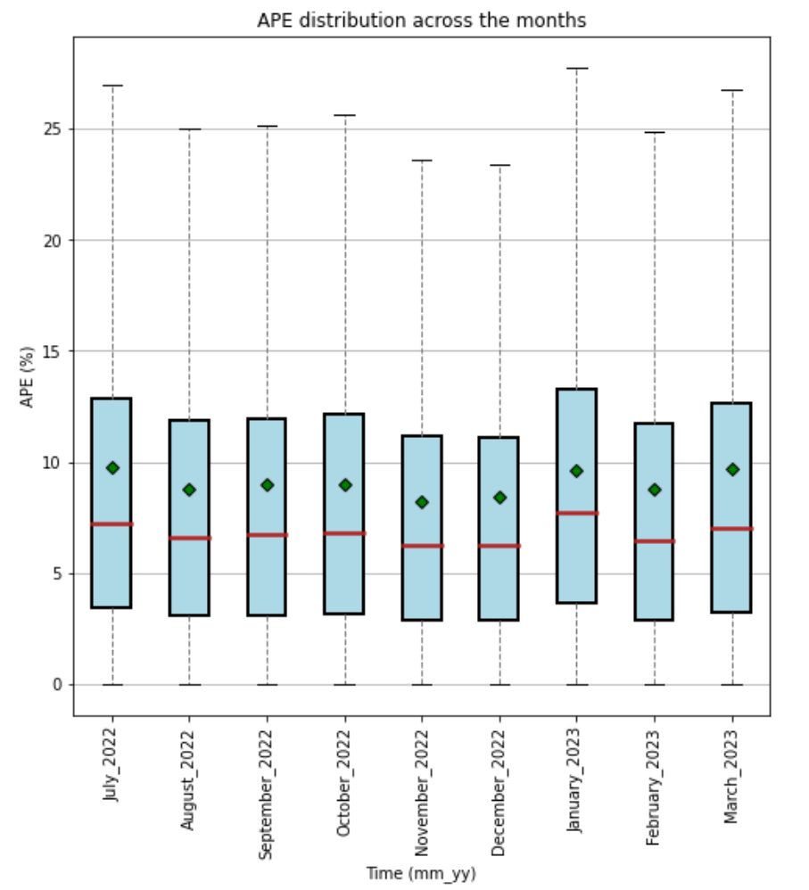
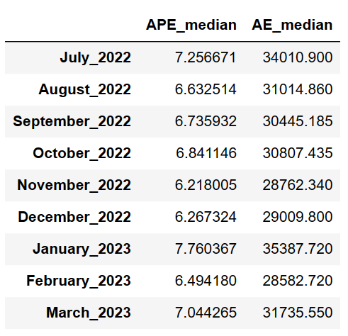
APE and AE
APE median: 6.2% to 7.8%
AE median: $28600 to $35400

Slide 30
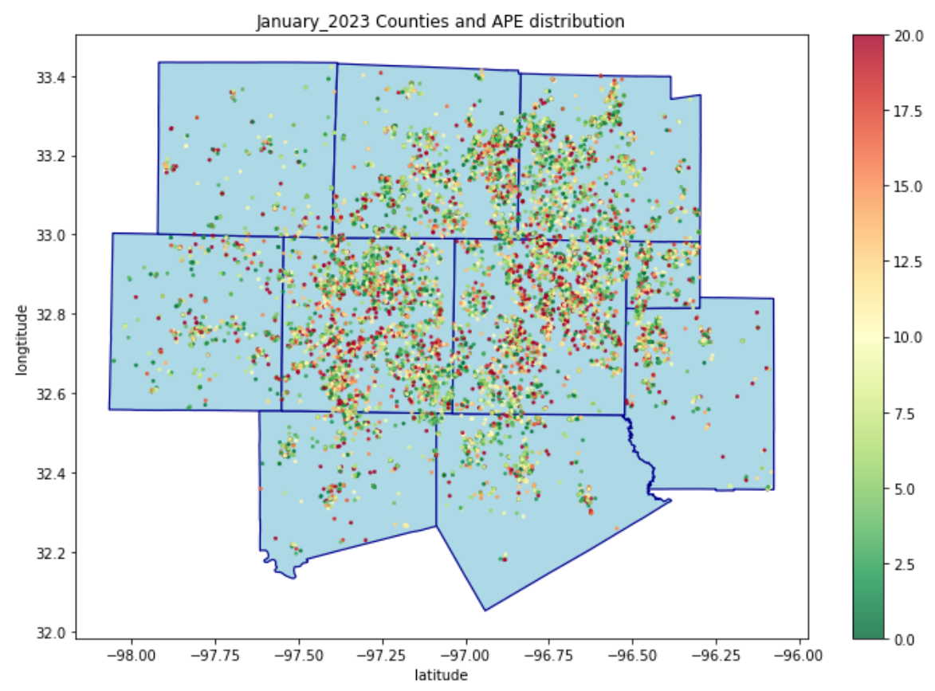
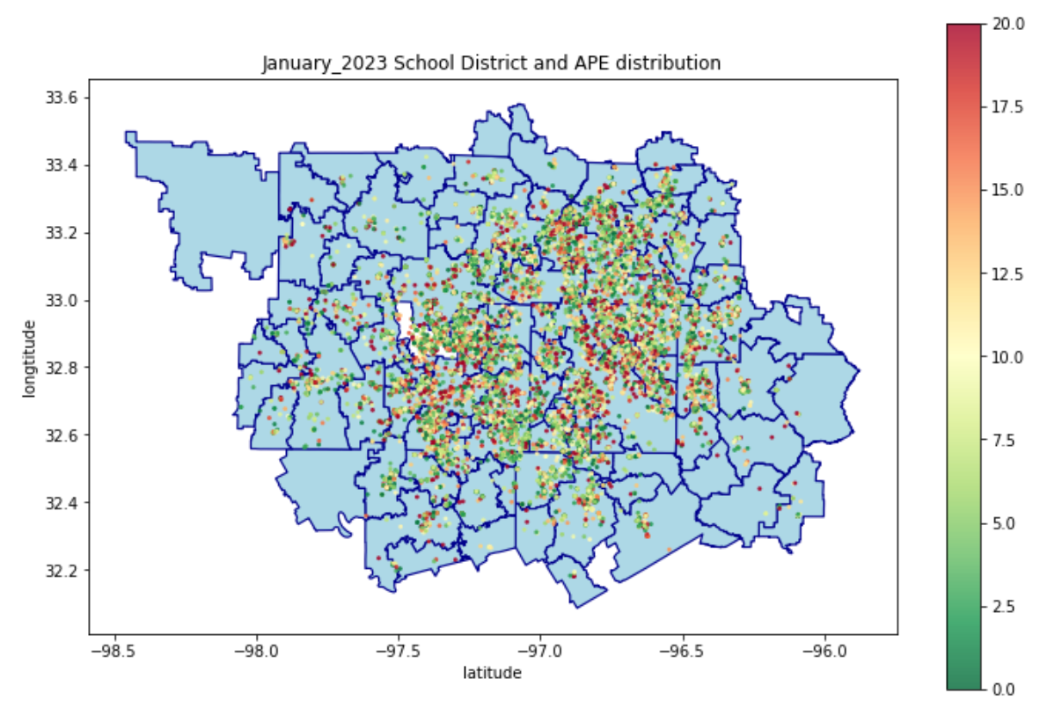
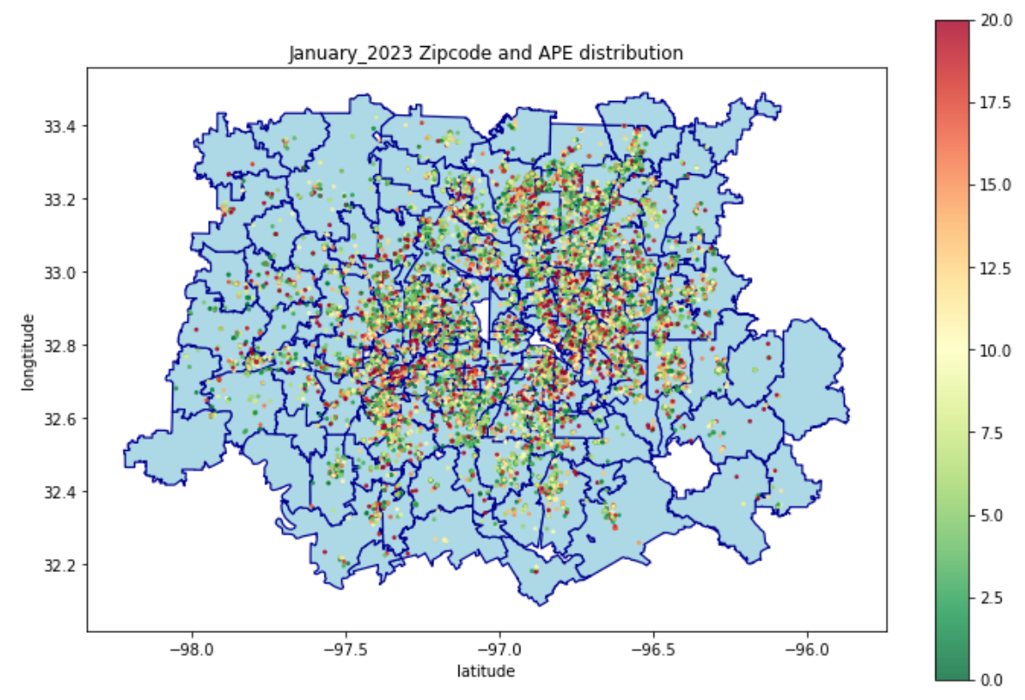
MAP OF APE DISTRIBUTION
WISE
DENTON
COLLIN
PARKER
ROCKWALL
TARRANT
DALLAS
KAUFMAN
JOHNSON
ELLIS

Slide 31
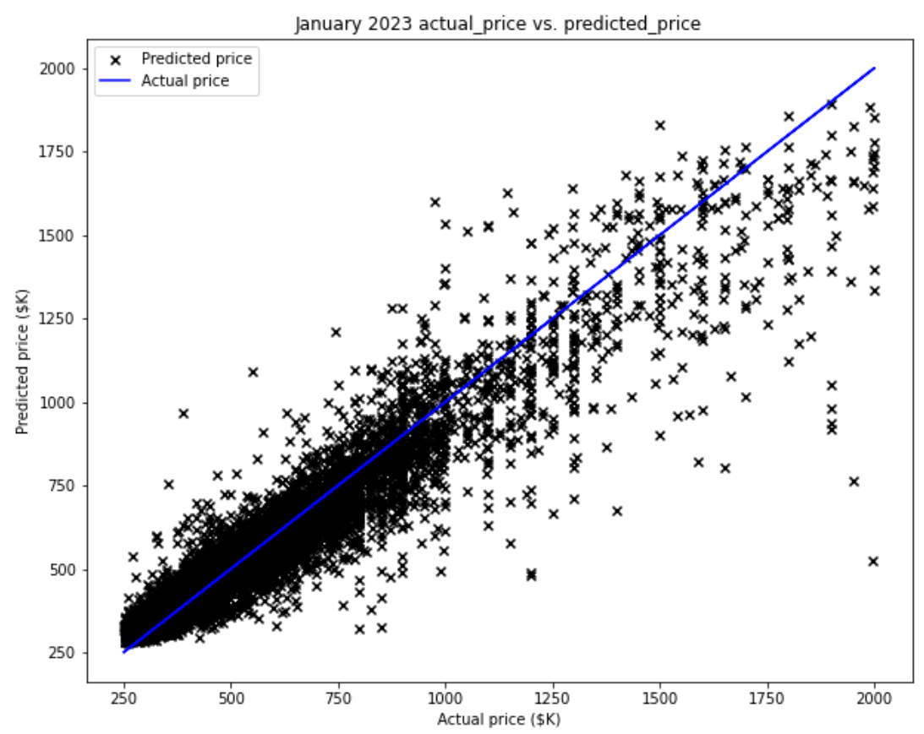
Actual_price vs. predicted_price in January 2023

Slide 32
Next steps in this project
Collect more data: Rapid Api just released housing price history so we can collect more houses with their latest prices.
Time Series Analysis on housing price.

